Slide 1

Software Testing
Introduction
Instructor: Kaveh Eshraghian

Slide 2
Overview
Introduction to testing
Importance of testing
Types of testing

Slide 3

Introduction
Software is one of the most complex things built by humans.
Complexity of modern software is such that it stretches the mental capabilities
Expected outcomes:
Producing correct results.
Working with edge cases.
Have required efficiency.
Maintaining high loads.
Sensible feedback when receiving bad data.
Error-free Integration
Recovery from error.

Slide 4

Software Testing
Definition:
As per ANSI/IEEE 1059, “Testing in Software Engineering is a process of evaluating a software product to find whether the current software product meets the required conditions”, such as:
Performance requirements
Functional requirements
Security requirements
Bug-free functionality
Outcome:
Identifying missing requirement
Identifying presence of bug/errors
Identifying security/reliability issues
Identifying performance issues

Slide 5
Testing Takeaway
Testing proves that the tests you ran work correctly.
01
Passing the tests does not ensure that your software is correct.
02
A software could pass all tests with flying colors, yet still have undiscovered bugs.
03
The number of bugs discovered is proportional to the amount of time spent debugging.
04

Slide 6

Debugging
Definition:
Debugging is the process of finding and fixing errors or bugs in the source code of any software.
Process:
Error identification (locating the source of the bug)
Error Analysis (determining how to fix the bug)
Fix and validation (implementing solution)

Slide 7
Testing vs. Debugging
Testing
Process of running the Software.
Debugging
Process of trying to locate bug
Determining the results.
Check to match expected outcome.
Fix located problem
Deploy solution

Slide 8
Famous Software Bugs
The First Bug
Therac-25
Ariane 5 disaster
Mars Climate Orbiter

Slide 9
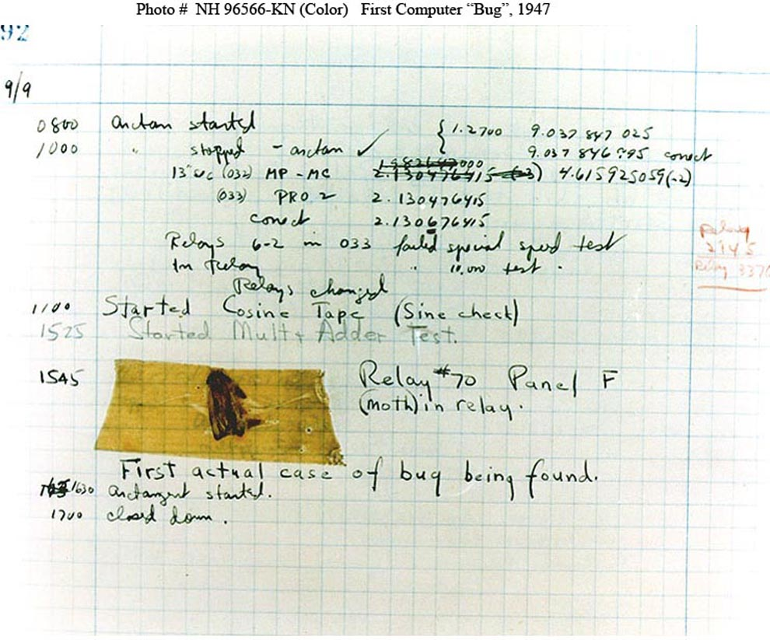
The First Bug
History:
Discovered in 1947 by Grace Hopper, who was the developer of the COBOL language.
While using the Harvard Mark II
Issue:
Calculation was not being performed correctly.
Cause:
A moth which was stuck between relays inside the computer.

Slide 10
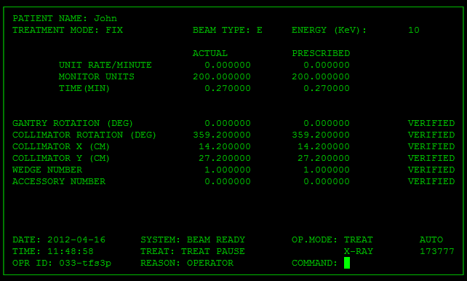
Therac-25
History:
A machine to treat cancer with radiation.
The original version used hardware stops to prevent errors.
The revised version used software to prevent errors.
Issue:
Provided patient with lethal dose of radiation.
Cause:
There was a bug in parallel programming.
The programmer did not understand how to do parallel programming.
Race condition

Slide 11
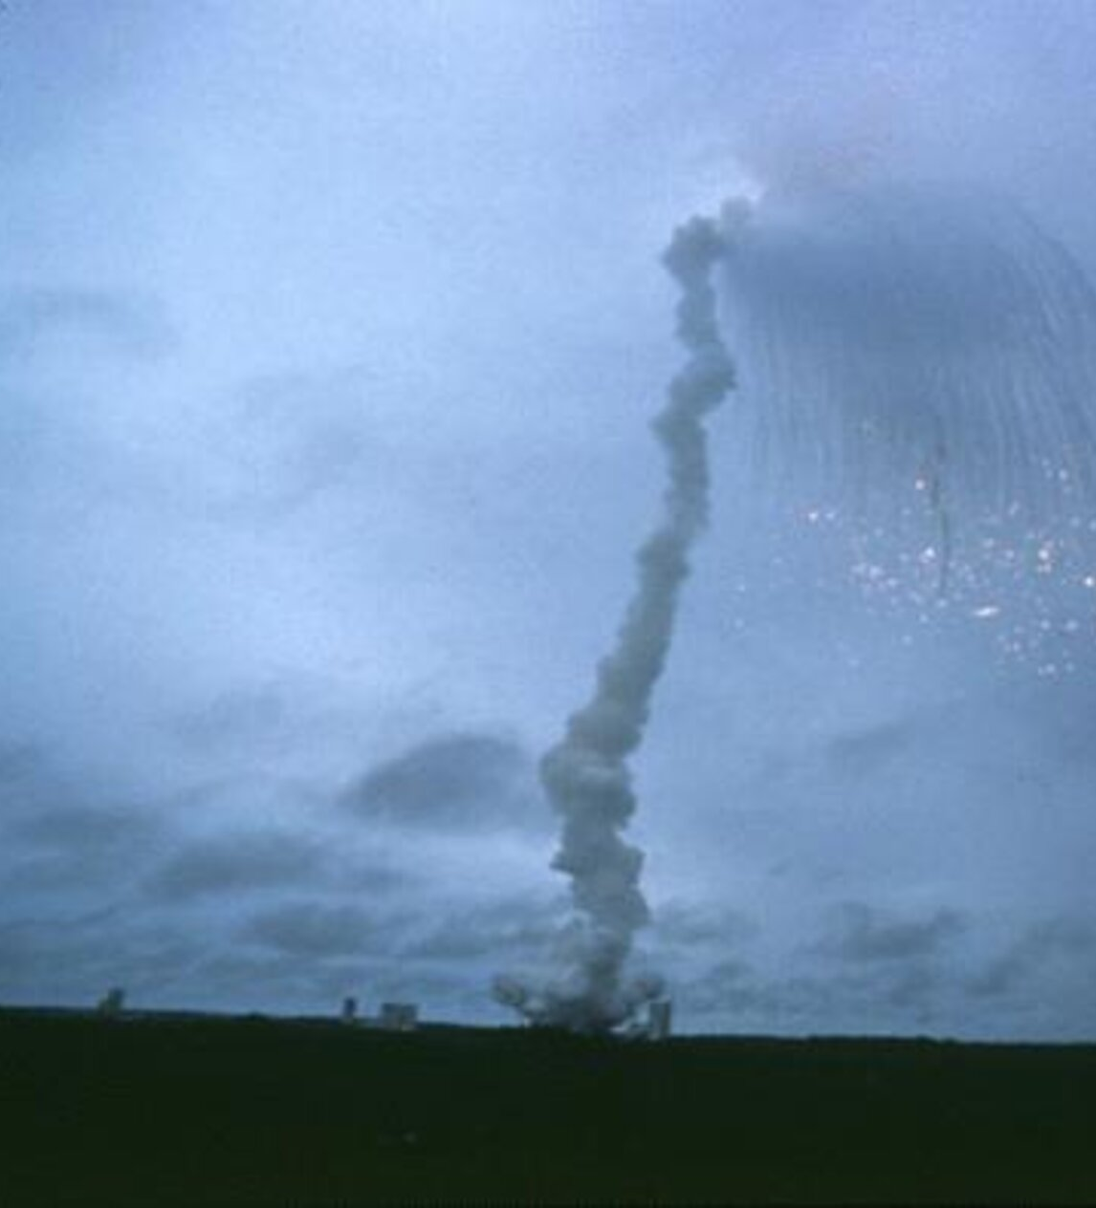
Ariane 5 Disaster
History:
In June of 1996 the very first Ariane 5 rocket was launched.
Issue:
37 seconds after launch, the rocket rotated 90 degrees, in the wrong direction.
less than two seconds later started to break up due to aerodynamic forces.
This triggered the Rockets self-destruction mechanism causing it to explode in midair.
This disaster cost approximately $370 million.
Cause:
A 64-bit floating-point value was used to track a guidance variable.
At some point in the calculation the value was assigned to a 16-bit integer.
It then sent incorrect values to the guidance system.

Slide 12
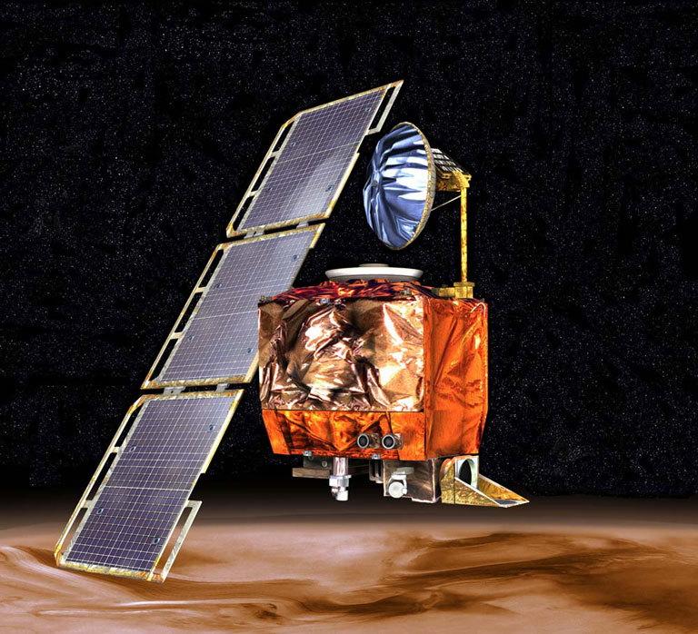
Mars Climate Orbiter
History:
A robotic space probe launched by NASA on December 11, 1998.
act as the communications relay in the Mars Surveyor '98 program for Mars Polar Lander.
$235 million weather satellite
Issue:
On September 23, 1999, communication with the spacecraft was permanently lost as it went into orbital insertion.
Either destroyed in the atmosphere or escaped the planet's vicinity and entered an orbit around the Sun.
Cause:
Result of several different problems occurring at the same time.
Bug in the ground control software. Convert Imperial unit to metric unit.
Lack of communication between various parts of the teams.

Slide 13
Types of Testing
Unit testing
Black box
White box
Integration
Functional
End-to-end
Load
Security
Acceptance
Regression

